Slide 1
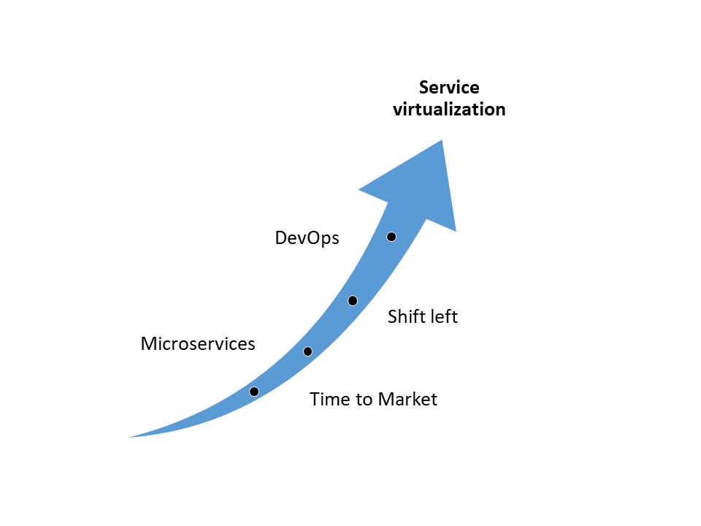
Test pyramid

Slide 2
Service virtualization Success depends on proper approach
Lukasz Stefaniszyn
Solution Architect

Slide 3




Test pyramid
UI
Service
Unit
Black-box testing:
System tests
Integration tests
White-box testing:
Components tests
Unit tests
Martin Folwer - https://martinfowler.com/bliki/TestPyramid.html

Slide 4
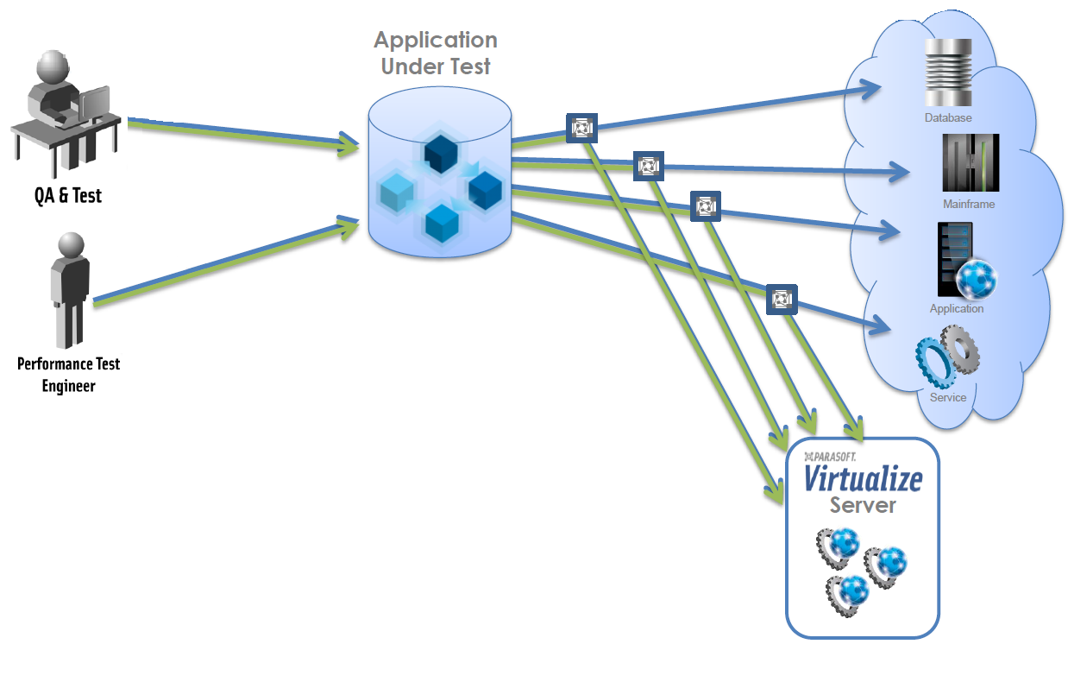
Test framework
Target: Define scope of DevOps test automation
Input:
organization test strategy
Output:
virtualization strategy
Service is unavailable
Data given by service are changing to often
Simulate all possible type of data served by service
Simulate alarms from service

Slide 5
Application Under
Test
WebAPI
/hello
DataBase

Slide 6
Application structure with virtualized back-end
Classic application structure
Application Under
Test
WebAPI
/hello
DataBase
Classic application structure with virtualization
Virtualized service
Application Under
Test
Proxy Binder
WebAPI
/hello
DataBase
Virtual assets
/hello

Slide 7
Virtualized service
Application Under
Test
Proxy Binder
WebAPI
/hello
DataBase
Virtual assets
/hello

Slide 8
Binding in service virtualization
Virtualized service
Application Under
Test
Proxy
Binder*
WebAPI
/hello
DataBase
Virtual assets
/hello
WebAPI
/welcome
DataBase
Virtual assets
/welcome
*) Bind request message with either virtual asset or real endpoint

Slide 9





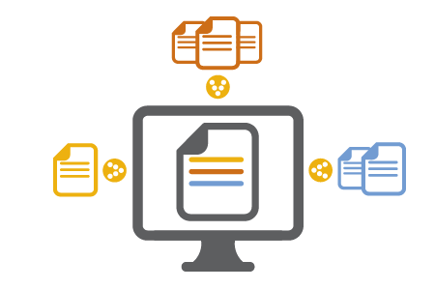


Service virtualization – success story
QA Engineers
3rd party applications
Performance Test Engineers
Application Under Test/ Development
Proxy Binder
Proxy Binder
Services
REST, SOAP
DEV Engineers
Proxy Binder
Database
WireMock Service Virtualization
iOS Financial App
Service is unavailable
Service under development
Simulate possible type of data served by service
Simulate alarms from service
Enabled smoke tests with virtual backend
Simulate services (Summary, Login, …)
Number of virtualized services - xx
Virtual assets along app repo

